Slide 1
REACHING NEW LIMITS
WITH
BETTER TOGETHER
Presented by: Alisha Pitts and Robert Yowell

Slide 2

Opening Prayer

Slide 3

Devotion

Slide 4


Take Me Out to the Ball Game

Slide 5

Team Kairos
Head Coach: JESUS
Assistant Coach: Bob Yowell
Assistant Coach: Alisha Pitts
Players: ALL OF US

Slide 6
INTRODUCTION TO KAIROS
WHAT IS KAIROS?
Kairos Prison Ministry International, Inc. (Kairos) is a Christian faith-based ministry which addresses the spiritual needs of incarcerated men, women, youth, and their families.
By sharing the love and forgiveness of Jesus Christ, Kairos hopes to change hearts, transform lives and impact the world.
As a ministry, Kairos embraces a diverse group of volunteers working together to fulfill Christ's call to action.

Slide 7
INTRODUCTION TO KAIROS
WHAT IS KAIROS?
Kairos is a ministry of the church ... a ministry of the apostles whom Jesus, the Christ, has called into community and sent forth into the environment of the correctional institution.
The word, Kairos, is a Greek word meaning in God's Special Time or in the Fullness of Time indicating an opportunity for our participants and guests to re-consider their life choices.

Slide 8
VISION
A community spiritually freed from the effects of imprisonment
reaching all impacted by incarceration, through the love, hope,
and faith found in Jesus Christ.

Slide 9
MISSION
The mission of the Kairos Prison Ministry is to share the transforming
love and forgiveness of Jesus Christ to impact the hearts and
lives of incarcerated men, women and youth, as well as
their families, to become loving and productive citizens of their communities.

Slide 10




KAIROS PROGRAM STRUCTURE

Slide 11
Kairos Prison Ministry is made up of three programs:
Kairos Inside
Kairos Outside
Kairos Torch.
One Ministry, One Mission, Three Programs

Slide 12
Kairos Inside
Kairos Inside, founded in 1976, with a focus on supporting incarcerated individuals.

Slide 13
Kairos Inside
    God has faithfully sustained Kairos for 50 years, and as we celebrate that journey that he’s taken us on, we also give thanks for the blessings of Kairos Outside and Kairos Torch. We look ahead with hope to what He will do in the next 50 years.
    WHAT A JOURNEY …AND BETTER TOGETHER!

Slide 14
Kairos Inside
The program strategy involves engaging both positive and negative leaders within the institution.
The initiative consists of a three-and-a-half-day weekend event.
Following the event, participants establish small Prayer and Share groups and hold monthly reunions supported by the Chaplain.

Slide 15
Kairos Outside
Kairos Outside, established in 1990, is designed to support female loved ones of individuals who are or have been incarcerated.

Slide 16
Kairos Outside
The program implements a strategy that demonstrates grace and compassion through Christian support, specifically for women and former residents who were unable to participate in Kairos Inside during their incarceration.
This two-and-a-half-day event provides an opportunity to engage in spiritual growth, develop a relationship with God, and encourages ongoing involvement in Support Groups and quarterly Reunions.

Slide 17
Kairos Torch
The Kairos Torch program, established in 1997, was designed to provide support for incarcerated youth.

Slide 18
Kairos Torch
The holistic program strategy is to introduce incarcerated youth to Christian mentoring, recognize the masks they wear, and process the value of forgiveness of self and others.
Two-and-a-half-day Weekend experience.

Slide 19
Kairos Torch
The long-term mentoring relationship is characterized by weekly mentoring sessions and monthly Reunion meetings. These provide youth with another way to look at their life while inside, prepare for life outside, and develop a vision of success upon release.
After their commitment to mentoring has ended, a group Bible Study is offered for those youth interested in continuing their spiritual journey.

Slide 20

BETTER TOGETHER

Slide 21
What Is Better Together
Better Together is Kairos three programs, Kairos Inside, Kairos Outside, and Kairos Torch working together to impact individuals, families, and society.

Slide 22
How Incarceration affects families
Men, women, youth, and their families are directly impacted when a person is incarcerated.
Relationships may weaken
Financial strain can grow
Family roles may be disrupted or diminished

Slide 23
How the programs work together
When an individual participates in one of the Kairos programs:
    There’s a life, behavior, and attitude change that occurs as they experience the transforming love and forgiveness of Jesus Christ.
    An opportunity for greater renewal can take place when two or more individuals in the family unit attend a Kairos program.

Slide 24
How the programs work together
As each person is positively changed through Kairos, the family is directly impacted as they witness their loved one’s transformation and hear about their life-changing experience.
When the incarcerated adult or youth goes through Kairos Inside or Kairos Torch and the women in their life go through Kairos Outside, they have a positive parallel life changing experience.

Slide 25

METHODS FOR UNITING THE THREE PROGRAMS

Slide 26
Teamwork
What is teamwork:
Teamwork is a unified, purpose-driven collaboration among believers to fulfill God’s mission, support one another, and strengthen the body of Christ.
Why teamwork matters:
Strong teamwork helps volunteers represent all three programs together and reinforces the “Better Together” message.

Slide 27
How to strengthen teamwork across the ministry
Become familiar with each Kairos Program: Kairos Inside, Kairos Outside, and Kairos Torch.
  Review materials for the programs you do not serve in so you can speak confidently about all three programs.
    Brochures
    Training videos on mykairos.org in the Training Tools section
    Ministry Program Manuals

Slide 28
How to strengthen teamwork across the ministry
Attend a presentation on a Kairos ministry you do not currently serve in to expand your understanding.
Once you are familiar with the ministry programs, prepare a brief elevator speech so you can explain them clearly when opportunities arise.

Slide 29
Fundraisers
Why fundraising matters:
Fundraising events do more than provide financial support. They also create opportunities to introduce people to all three Kairos programs and show how they work together to transform lives.
How the ministry programs work together:
Kairos Communities can work together to plan fundraising events, while Advisory Councils support those efforts through communication and coordination.

Slide 30

How to present the full Kairos Ministry at fundraising events
Display banners that highlight the three programs.
Provide handouts that explain each Kairos ministry.
If possible, have a video running to explain the three ministry programs
Invite one or two past graduates to share how Kairos affected their lives and their loved ones.
Share upcoming weekend and closing dates.
Provide prayer vigils for upcoming events that they can pray for.
Offer contact cards so visitors can express interest and learn ways to get involved.

Slide 31

Recruiting Ventures
Recruiting means stepping out in faith to invite others into the ministry.
Recruiting is essential to the strength and growth of all three Kairos ministry programs.

Slide 32
Effective ways to recruit:
Connect with people at work, in your neighborhood, at church, at mission events, and in other community settings.
    When appropriate, use tables, displays, conversations, and Kairos One Ministry Three Programs business cards to invite people to learn more and get involved.
    Be prepared to explain any of the three ministry programs at any event and show how Kairos can meet a person’s needs through the appropriate program.
        Share what you have seen God do through Kairos weekends and continuing ministry.
Live out the values of Kairos daily so others can see the ministry’s impact on your life.

Slide 33
From guest to long-term servant
Recruiting is not only about finding volunteers. It often begins by inviting someone to attend as a guest, and that first experience can lead to long-term service and continued involvement in the ministry.

Slide 34

Church Presentations
Contact churches to request:
Prayer for the ministry
Permission to present Kairos during a worship service or church event.
Financial support for Kairos as a mission

Slide 35
Helpful elements for a church presentation
Open with prayer and thank the church for the opportunity to share.
Share a brief overview of Kairos Prison Ministry.
  Explain how Kairos impacts participants, families, and institutions.
Show a Kairos video that fits the time available.

Slide 36
Helpful elements for a church presentation
If a graduate is present, invite them to share how Kairos changed their life.
Set up a table after the service or during the event with English and Spanish literature, handouts, sign-up materials, brochures and business cards for those interested in supporting the ministry, joining a team, or attending as a guest.
  Have experienced volunteers available to answer questions about all three ministry programs and help people get involved.

Slide 37

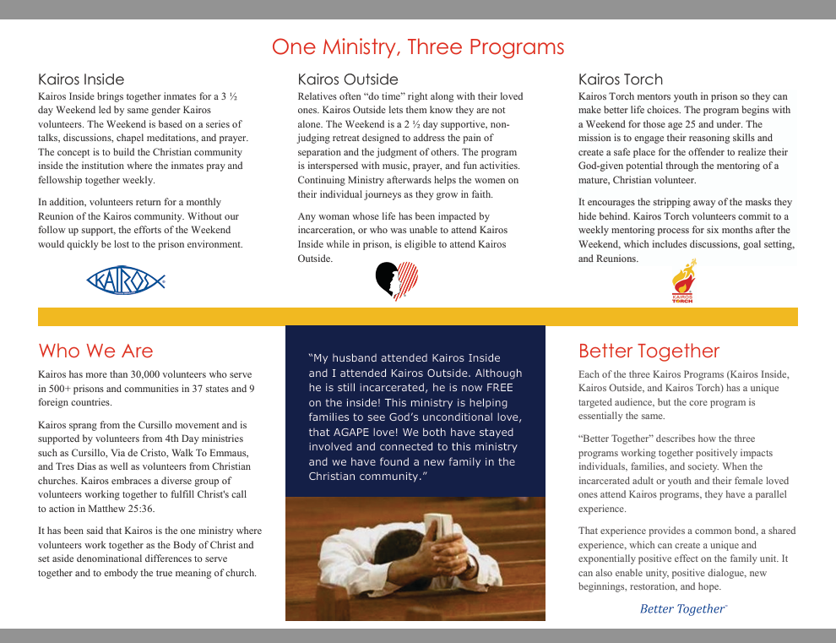
Kairos Prison Ministry International Brochures
General Kairos Brochure

Slide 38

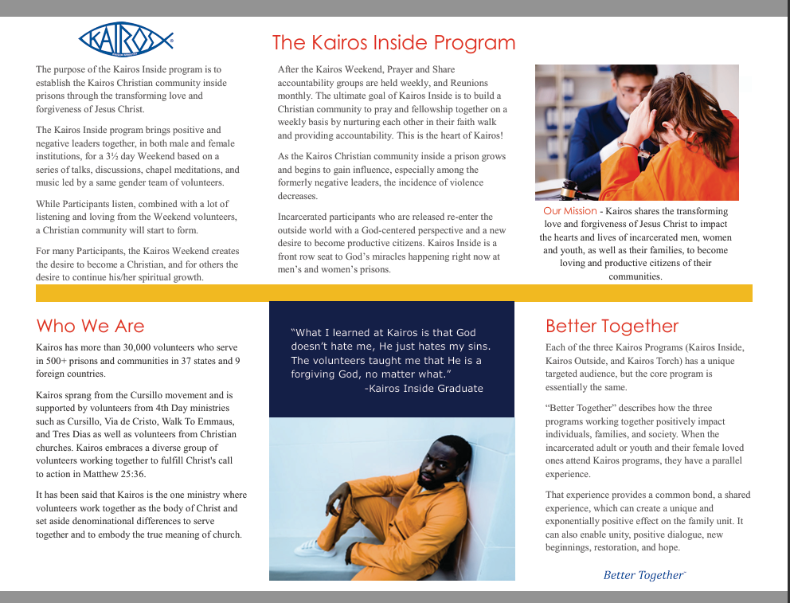
Kairos Prison Ministry International Brochures
Kairos Inside Brochure

Slide 39

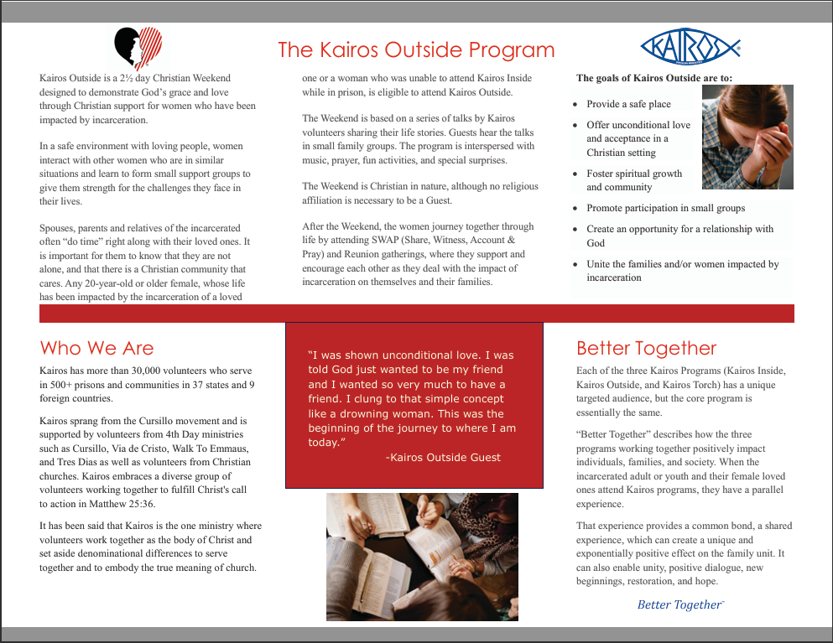
Kairos Prison Ministry International Brochures
Kairos Outside Brochure

Slide 40


Kairos Prison Ministry International Brochures
Kairos Outside Guest Brochure

Slide 41

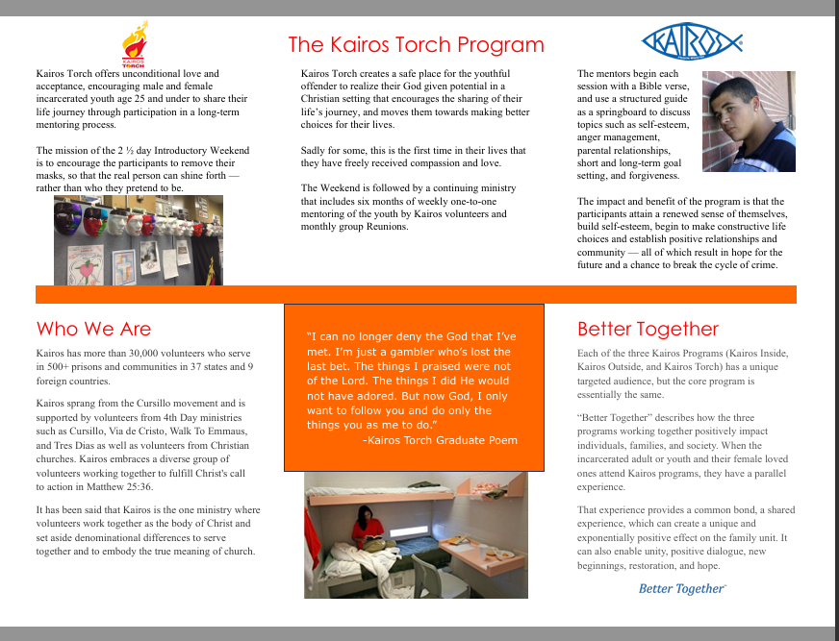
Kairos Prison Ministry International Brochures
Kairos Torch Brochure

Slide 42
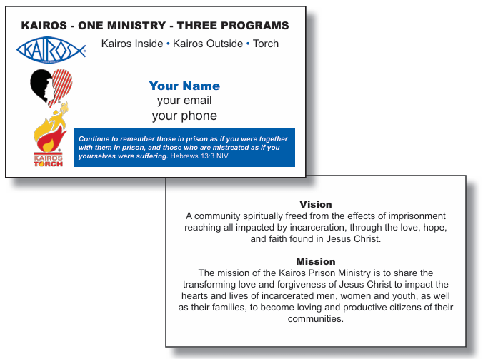
Business Cards

Slide 43
Closings
Why Closings Matter:
Closings give attendees a meaningful opportunity to hear how God has changed the lives of Weekend residents and guests through the Kairos experience.
Share the full Kairos mission:
Highlight all three Kairos ministry programs during the closing so graduates and attendees gain a clear understanding of the ministry’s full mission and reach.

Slide 44
Closings
Share the full Kairos mission:
  Provide Kairos Outside applications to graduates of Kairos Inside, Kairos Outside, and Kairos Torch.
      Give extra copies to the chaplain for additional distribution as needed.
Follow up after closing:
If you invite someone to a closing, follow up soon afterward. Let them know how they can support the ministry and share the many ways they can become involved.

Slide 45
As we continue to support One Ministry, One Mission, Three Programs, we remain committed to reaching new heights through Better Together and to helping the Kairos ministry celebrate the next 50 years.

Slide 46

QUESTIONS

Slide 47

Closing Prayer

Slide 48

T
ANOTHER 50 YEARS

